Slide 1
OpenRemote
Graduation Internship – Semester 8 - Fontys
Notes:
Welcome to my presentation!

Slide 2
Contents
Company
Assignment
Demo
Questions?
Notes:
First, I will give you an introduction about the company and my assignment. After that I will do a quick demo of the feature I’ve been working on in the past 10 weeks.

Slide 3
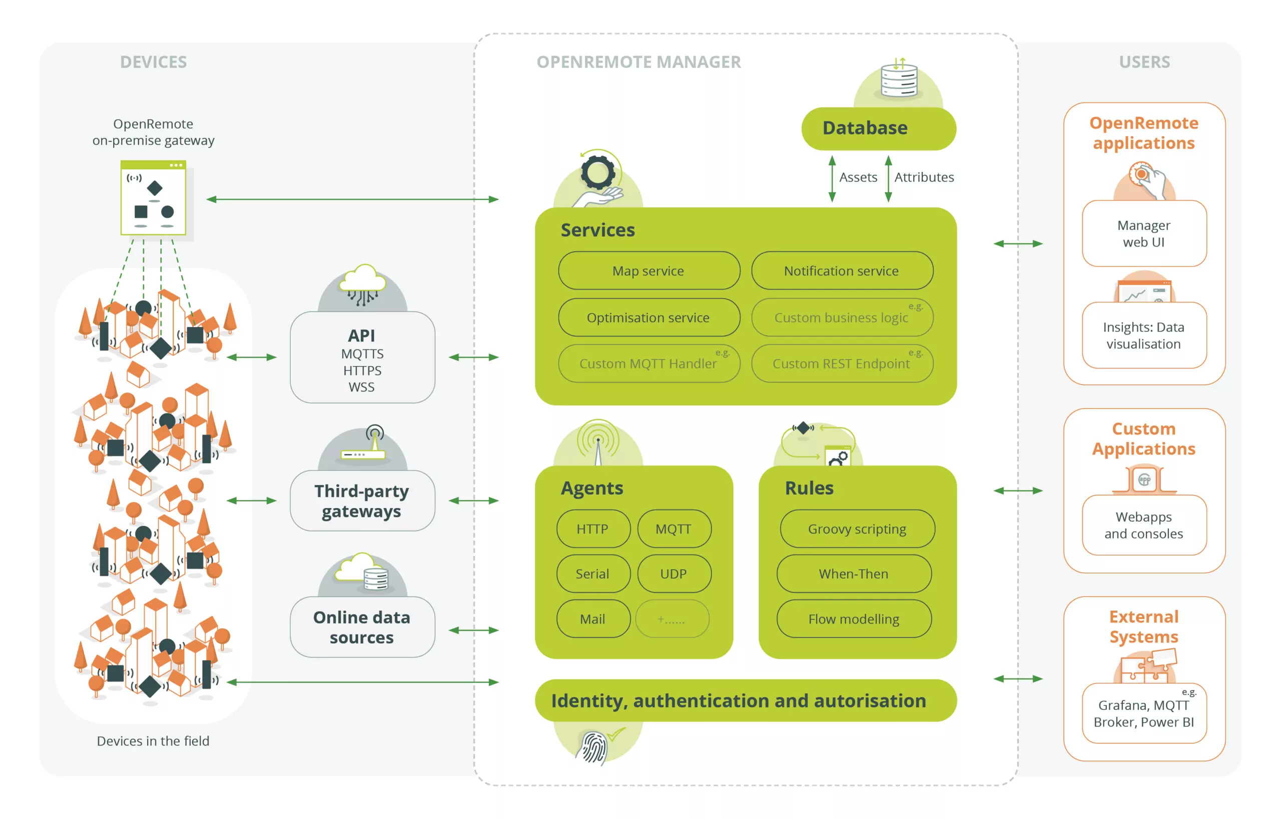

Company
Notes:
OpenRemote, founded in 2015, is an organization that develops an open-source IoT platform. The goal of the platform is to simplify the integration of different communication protocols and data sources into one user-friendly system.
The platform enables integration with different types of sensors, data sources, (IoT) devices, and allows them to be managed centrally through a user-friendly management portal. The data from these sources can then be visualized and used in customized applications and (mobile) apps.
The software is completely open-source, allowing anyone to use or contribute to it for free.

Slide 4






Assignment
Notes:
In addition to the open-source product, companies and (government) organizations can choose to have the software managed and maintained (for a fee) by OpenRemote. This so-called “managed” service is becoming increasingly popular, which brings new challenges.
One of the challenges is to maintain the virtual machines where OpenRemote is running on. These machines need to be updated regularly ranging from simple software updates to migrating to a new OpenRemote version.
Currently, all these tasks are performed manually, As the number of clients for the “managed” service increases, updating will take more and more time from the team member responsible for this task.
To automate this whole process, I’m working on various tasks. First, I started investigating how we can decouple the IoT data from the root volume and store it on a separate EBS data volume. This ensures that backups can be more targeted and reduces the risk of data loss during updates since the data is no longer attached to the same block device.
This feature is now fully functional and ready to be merged into the main codebase. I’ve automated the creation, mounting and attachment into their existing CI/CD pipeline using AWS CloudFormation and Bash. The script will also provision a policy for automatic snapshot creation to make sure that the volume is backed up at regular intervals. And on top of that I’ve added several CloudWatch metrics and alarms to monitor the health and performance of this block device.
I’ll show you a quick demo!

Slide 5
Demo
Notes:
Quick demo

Slide 6
Questions?
Notes:
Does someone have any questions?

Slide 7
End
Thank you for listening!
Notes:
That was my presentation, thank you for listening!

